Slide 1
Financial Sentiment Analysis Using Statistical and Neural NLP Approaches
Team#11 ​​
John Pretz
Manas Sahoo
Natural Language Processing (NLP)| AI574| (Fall, 2025)
Instructor’s Name: Prof. Bard

Slide 2
2 min to convince the audience
Context, Problem, teasing about the solution

Slide 3
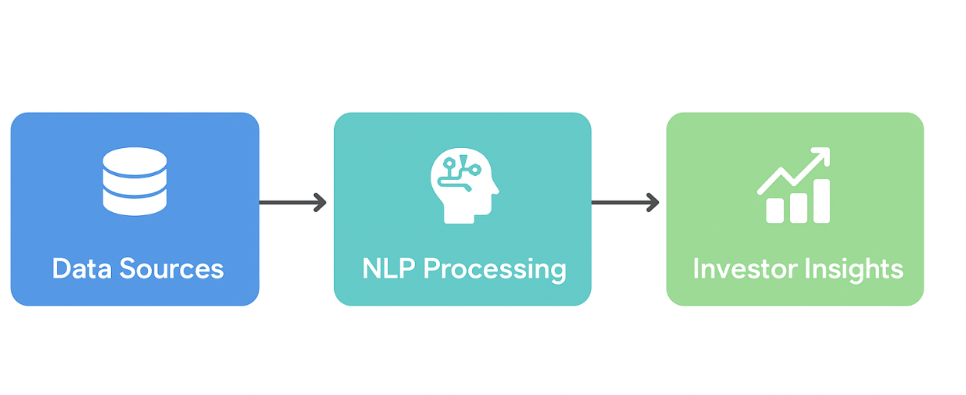
Context and Introduction
Introduction: Financial texts—news articles, social media posts, and earnings calls—reflect public perception and influence stock markets. With massive daily data, manual analysis is impossible. NLP automates sentiment extraction, providing actionable insights for investors. This project compares statistical and neural NLP methods to evaluate their effectiveness in capturing financial sentiment.
Key Points:
Stock markets are heavily influenced by public perception.
Sources include news, social media, and corporate reports.
Data volume is enormous → manual sentiment tracking is impractical.
NLP models enable automated sentiment detection to aid decision-making.
Goal: Compare statistical vs. neural NLP methods across diverse financial texts.

Slide 4
Problem and Challenges
Problem :
While financial text data is abundant—from news articles to social media posts and earnings calls—extracting reliable sentiment remains challenging. Financial language is highly domain-specific, often subtle, and context-dependent, making it difficult for traditional NLP models to accurately capture sentiment. Classical statistical methods like TF-IDF and n-grams provide baseline insights but fail to understand nuanced meaning, while advanced neural and transformer models aim to bridge this gap.
Challenges:
Financial sentiment analysis faces several unique challenges. Human language includes slang, sarcasm, and idioms, which can mislead models. Financial texts also contain domain-specific jargon, and datasets are often imbalanced across sentiment categories. Additionally, neural models risk overfitting, and deep learning approaches require significant computational resources, which can be a limitation without GPUs. Accurately modeling sentiment depth beyond simple positive, neutral, or negative labels is also a persistent difficulty.

Slide 5
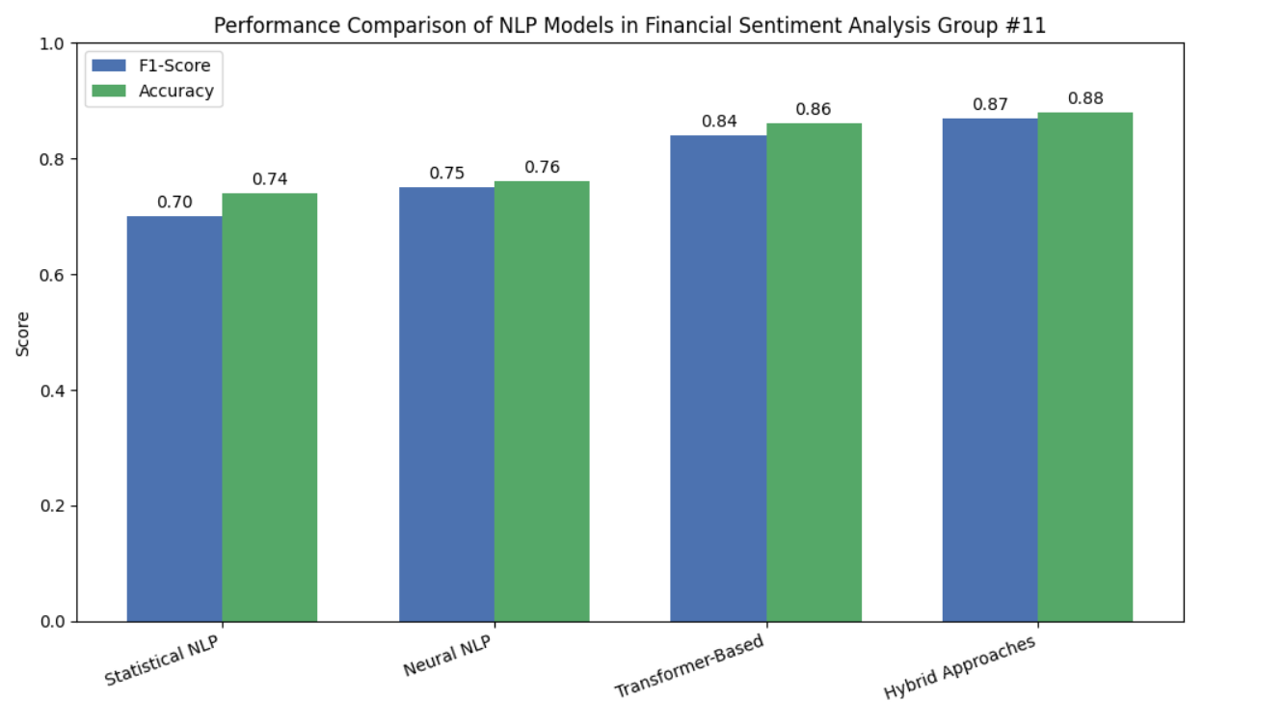
Related solutions / State of Art
Model Type | Examples | F1-Score | Accuracy | Pros | Cons
Statistical NLP | TF-IDF + Logistic Regression / SVM / Random Forest | ~0.65–0.75 | ~0.70–0.78 | Interpretable, reliable for smaller datasets | Fail to capture context, limited nuance in financial language
Neural NLP | LSTM, BiLSTM | ~0.70–0.80 | ~0.72–0.80 | Captures sequential dependencies, better context understanding | Limited on very long texts or highly nuanced sentiment
Transformer-Based | FinBERT, BERT, RoBERTa (fine-tuned) | ~0.80–0.88 | ~0.82–0.90 | Self-attention captures long-range context, domain-specific adaptation | Computationally heavy, may require large datasets
Hybrid Approaches | CNN-BiLSTM, FinBERT + BiLSTM | ~0.82–0.90 | ~0.84–0.91 | Combines statistical & deep learning strengths, improved F1-scores | More complex, harder to interpret, longer training times
The bar chart illustrates the performance of different NLP approaches in financial sentiment analysis. It shows that hybrid models achieve the highest F1-score and accuracy, followed by transformer-based, neural, and statistical models, highlighting the progressive gains in performance from classical to advanced methods.

Slide 6
Overview of Solution / Contributions
Team Member | Email | Responsibilities / Contributions | Notes
John Pretz | jjp6846@psu.edu | - Data collection from Kaggle, Hugging Face, earnings calls | Focused on statistical NLP baseline and dataset management
 |  | - Data preprocessing, cleaning, tokenization
 |  | - Feature engineering for statistical NLP models (TF-IDF, n-grams)
 |  | - Training & evaluation of Logistic Regression and SVM models
Manas Sahoo | mr.sahoo@psu.edu | - Implementation of neural NLP models (LSTM, BiLSTM) | Focused on neural and transformer models, model comparison, and performance visualization
 |  | - Transformer-based model fine-tuning (FinBERT, RoBERTa)
 |  | - Hyperparameter tuning, regularization, handling imbalanced datasets
 |  | - Evaluation metrics analysis and visualization

Slide 7
Data Collecting

Slide 8
Data Preprocessing

Slide 9
Methodology
JOSE
…

Slide 10
Model selection and parameters
Normalization, regularization, data augmentation, layers, activation functions, Tuning,

Slide 11
Network Training – Validation - Testing

Slide 12
Evaluations – Performance – comparing
Baseline models

Slide 13
Lessons learned and Perspectives

Slide 14
Outcomes/finding

Slide 15
Demo !

Slide 16
Bibliographical References
References
Apart from different data sources, we also studied and will continue to explore additional resources based on prior work done on the same topic:
Research Papers & Articles
Yu, C., Zhen, X., Yuan, C., Yuhan, W., Zhengao, L., & Jinsong, L. (2025). A Deep Learning Framework Integrating CNN and BiLSTM for Financial Systemic Risk Analysis and Prediction. https://doi.org/10.48550/arXiv.2502.06847
Cheng, W., & Chen, S. (2021). Sentiment Analysis of Financial Texts Based on Attention Mechanism of FinBERT and BiLSTM. In ICCEA, 73–78. IEEE. https://doi.org/10.1109/ICCEA53728.2021.00022
Cai, R., Qin, B., Chen, Y., Zhang, L., Yang, R., Chen, S., & Wang, W. (2020). Sentiment Analysis About Investors and Consumers in Energy Market Based on BERT-BiLSTM. IEEE Access, 8, 171408–171415. https://doi.org/10.1109/ACCESS.2020.3024750
Ahmed, W., Semary, N., Amin, K., & Hammad, M. A. (2023). Sentiment Analysis on Twitter Using Machine Learning Techniques and TF-IDF Feature Extraction: A Comparative Study. IJCI, 10, 52–57. https://doi.org/10.21608/ijci.2023.236052.1128
Wahyuningsih, T. (2024). Analyzing Sentiment Trends and Patterns in Bitcoin-Related Tweets Using TF-IDF Vectorization and K-Means Clustering. Journal of Current Research in Blockchain, 1, 48–69. https://doi.org/10.47738/jcrb.v1i1.11
Popoola, G., Abdullah, K.-K., Fuhnwi, G. S., & Agbaje, J. (2024). Sentiment Analysis of Financial News Data Using TF-IDF and Machine Learning Algorithms. In ICAIC, 1–6. IEEE. https://doi.org/10.1109/ICAIC60265.2024.10433843
Fatouros, G., Soldatos, J., Kouroumali, K., Makridis, G., & Kyriazis, D. (2023). Transforming Sentiment Analysis in the Financial Domain with ChatGPT. Machine Learning with Applications, 14, 100508. https://doi.org/10.1016/j.mlwa.2023.100508
Ardekani, A. M., Bertz, J., Bryce, C., Dowling, M., & Long, S. (2024). FinSentGPT: A Universal Financial Sentiment Engine? International Review of Financial Analysis, 94. https://doi.org/10.1016/j.irfa.2024.103291
Moradi-Kamali, H., Rajabi-Ghozlou, M.-H., Ghazavi, M., Soltani, A., Sattarzadeh, A., & Entezari-Maleki, R. (2025). Market-Derived Financial Sentiment Analysis: Context-Aware Language Models for Crypto Forecasting. http://arxiv.org/abs/2502.14897
Shen, Y., & Zhang, P. K. (n.d.). Financial Sentiment Analysis on News and Reports Using Large Language Models and FinBERT.

Slide 17
Bibliographical References(Cont)
Research Papers & Articles
Nasiopoulos, D. K., Roumeliotis, K. I., Sakas, D. P., Toudas, K., & Reklitis, P. (2025). Financial Sentiment Analysis and Classification: A Comparative Study of Fine-Tuned Deep Learning Models. IJFS, 13(5), 75. https://doi.org/10.3390/ijfs13020075
Du, K., Xing, F., Mao, R., & Cambria, E. (2024). Financial Sentiment Analysis: Techniques and Applications. ACM Computing Surveys, 56(10), 1–42. https://doi.org/10.1145/3649451
Araci, D. (2019). FinBERT: Financial Sentiment Analysis with Pre-Trained Language Models. arXiv. https://doi.org/10.48550/arXiv.1908.10063
Web Resources
Rivery Big Data Statistics
Plutchik Wheel of Emotions
Positive Psychology Emotion Wheel
Datasets
Kaggle: Sentiment Analysis for Financial News
Kaggle: Twitter Financial News Sentiment Dataset
Kaggle: Financial Tweets Sentiment
Hugging Face: Financial PhraseBank
Hugging Face: Synthetic Financial Tweets Sentiment
Dataverse Financial Dataset

Slide 18
Backup slides

